Slide 1
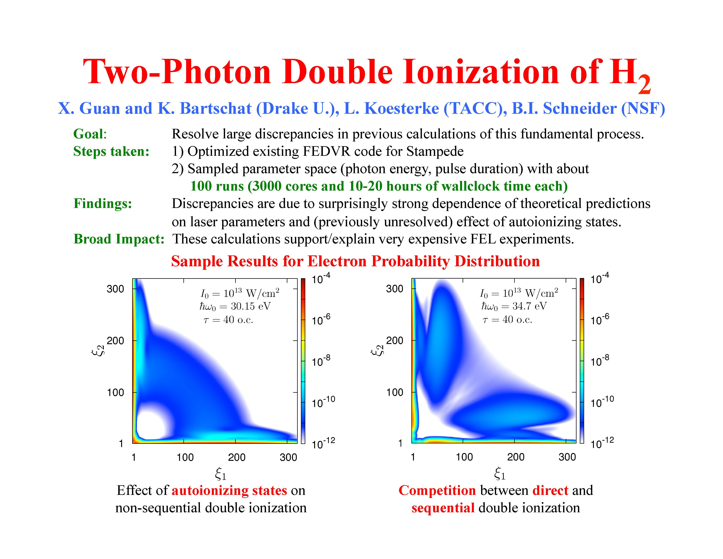
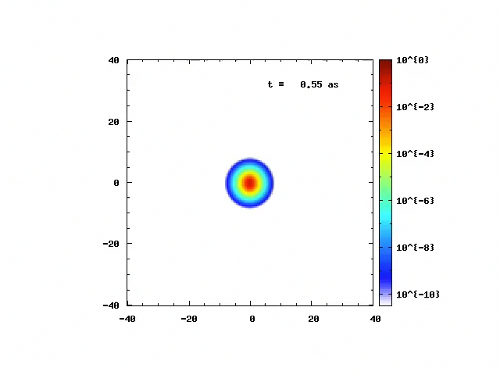
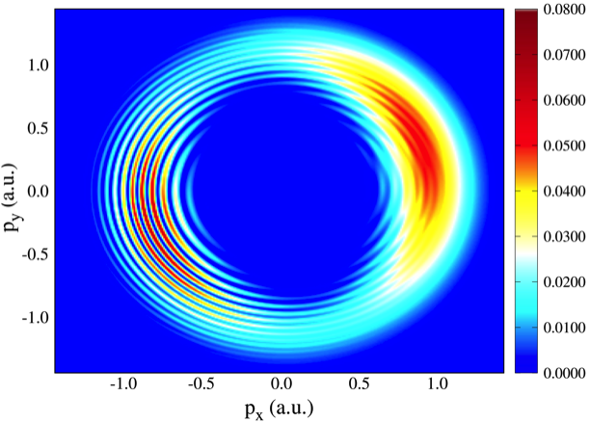
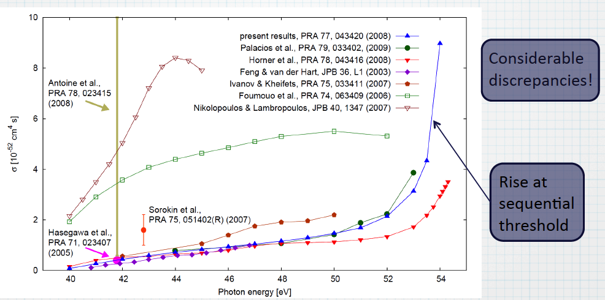
H⁺₂ Ionization in strong, ultrafast
electromagnetic field
Ionization of Ar(3d) by electron Impact:
Experiment(a) and Theory(b)
2-Photon Double Ionization in He: Approching the Sequential Threshold
Photoelectron Momentum Distribution for Ar
Ionization in Strong Electromagnetic Field

